Slide 1
How did Sachin make the first double century in ODI men’s cricketing history 200*(147)
In contrast with New Zealand’s Ross Taylor who made 185*(147)

Slide 2
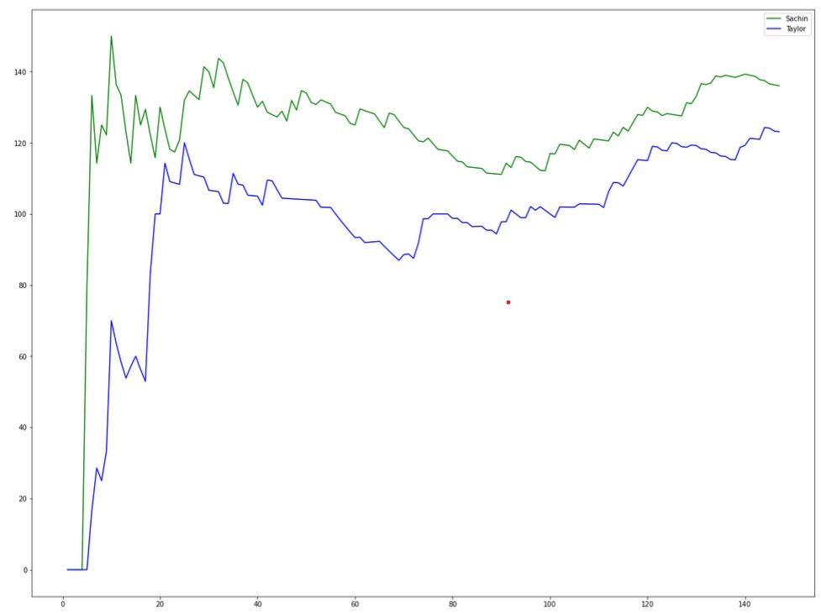
Lets take a look at the variation of variation of strike rate of the both the players through their respective innings
As you can see right from the first ball of his innings sachin maintained a higher strike rate as compared to Taylor
Sachin’s average strike rate was 122.8
Whereas Taylor’s average strike rate was 97.06
Through the middle overs:
Sachin allowed his strike rate to befall only till 111.11
Whereas Taylor went down to 86.96
In the death overs
Sachin went up to 139.29 with an average of 134.48
Taylor’s strike rate went up to 124.31 with an average of 119.10

Slide 3
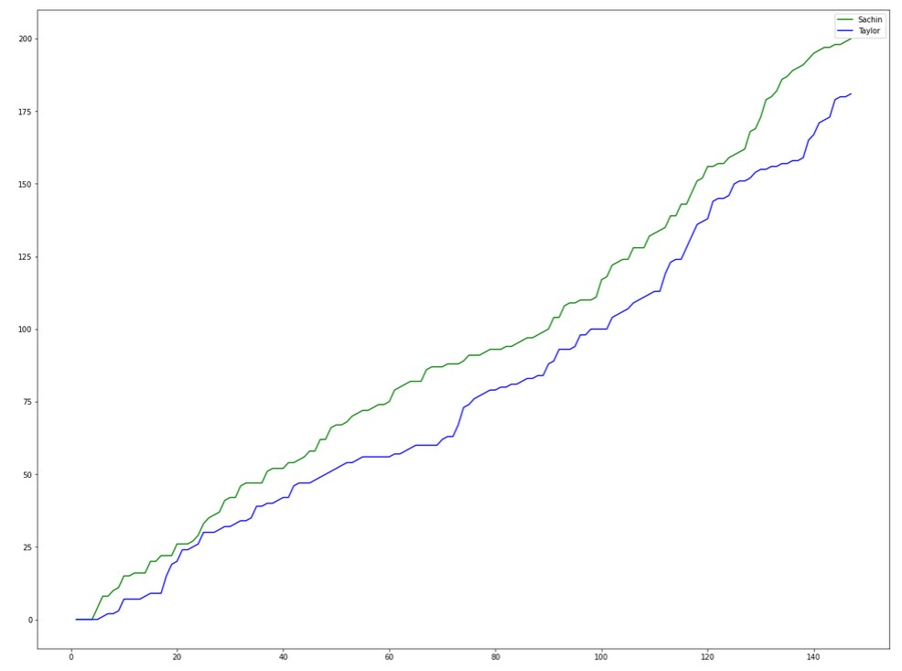
A glimpse into the scoring rate of both the players
In the powerplay(Overs 1-15)
Sachin: 62 runs in 48 balls( 1.29 run per ball)
Taylor: 39 runs in 35 balls(1.11 runs per ball)
Through the middle overs
Sachin: 71 runs in 61 balls(1.16 runs per over)
Taylor: 61 runs off 66 balls(0.92 runs per balls)
In the death overs:
Sachin: 48 runs off 28 balls(1.71 runs per ball)
Taylor: 69 runs in 38 balls(1.81 runs per ball)

Slide 4
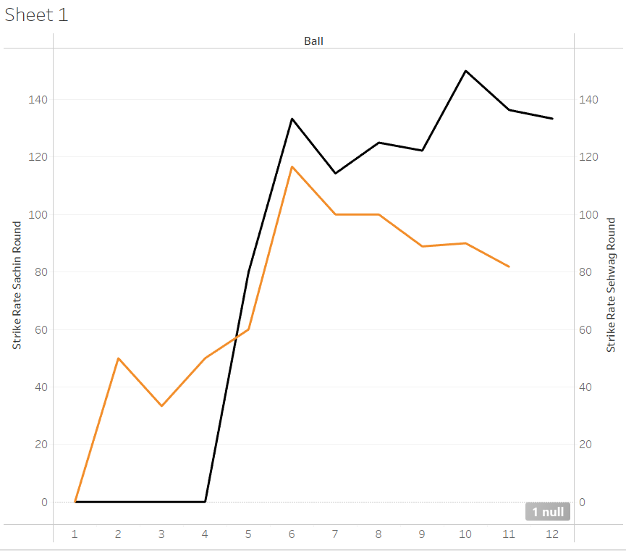
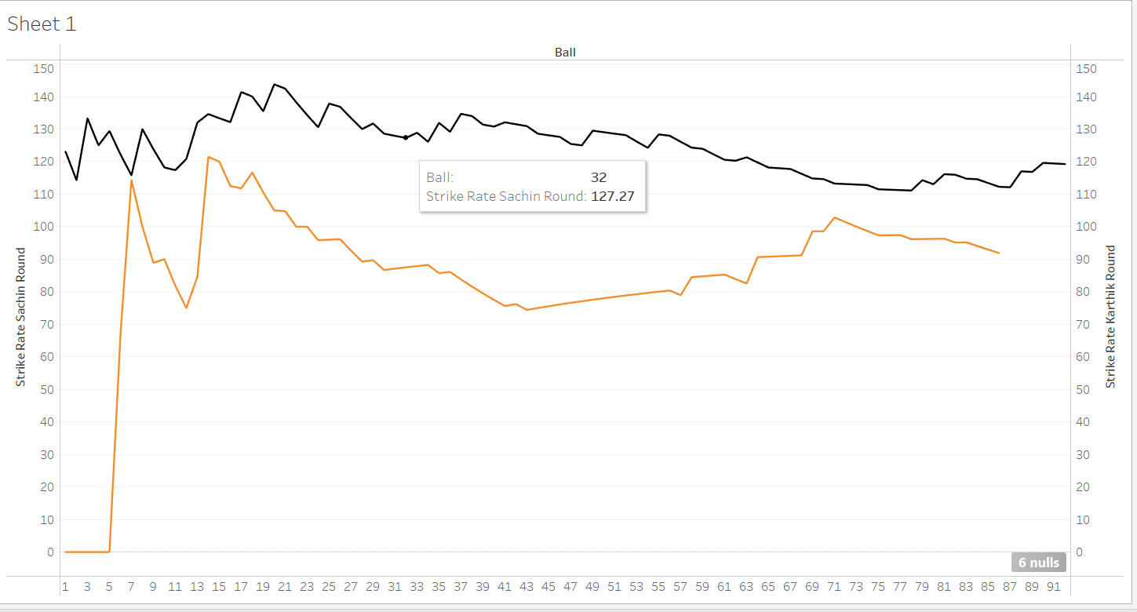
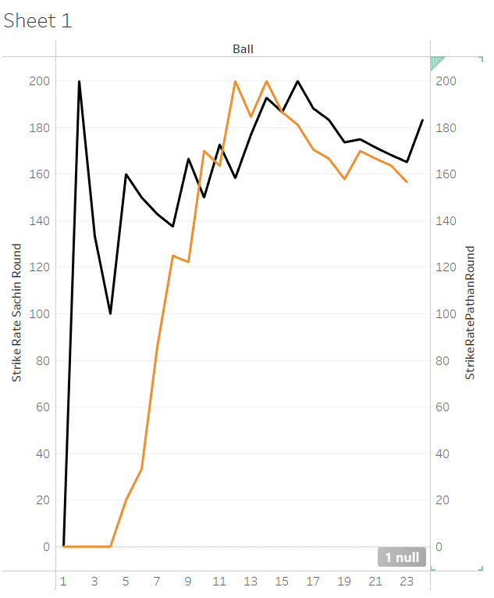
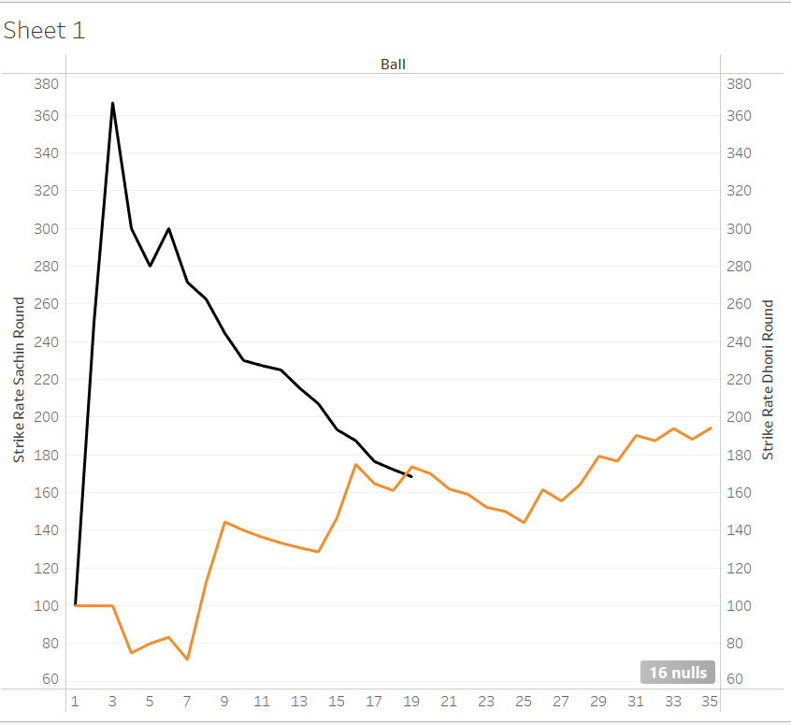

Slide 5
Sachin and his partner batsman
Sehwag opened with him and went early [made 9 off 11]
Sachin and Karthik had a crucial partnership where Karthik(79 off 86)
And Sachin(108 runs off 92 balls) this defined his innings and paved the way for a double hundred
This partnership with Karthik had an excellent rotation of strike
With pathan both of them played with a very high strike rate
Pathan’s average(122.8)
Sachin’s Average(159.8)
With Dhoni sachin played with a whopping strike rate of 230.4

Slide 6
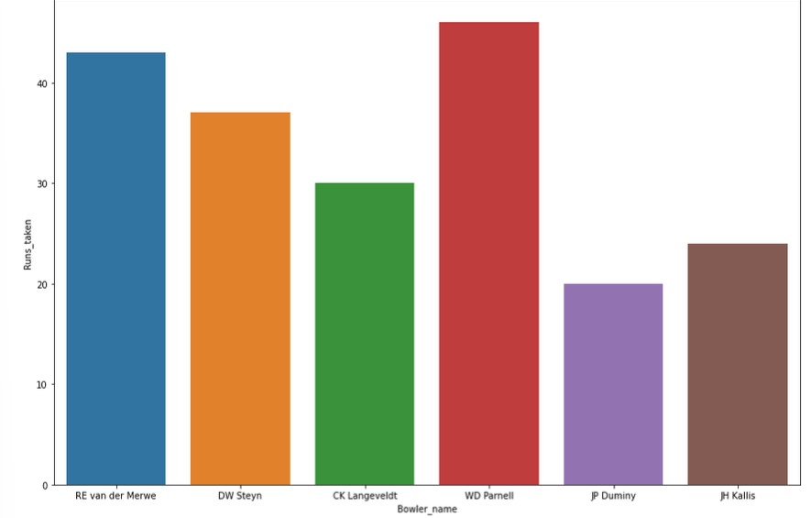

Slide 7
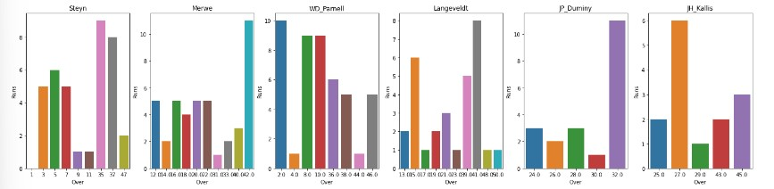
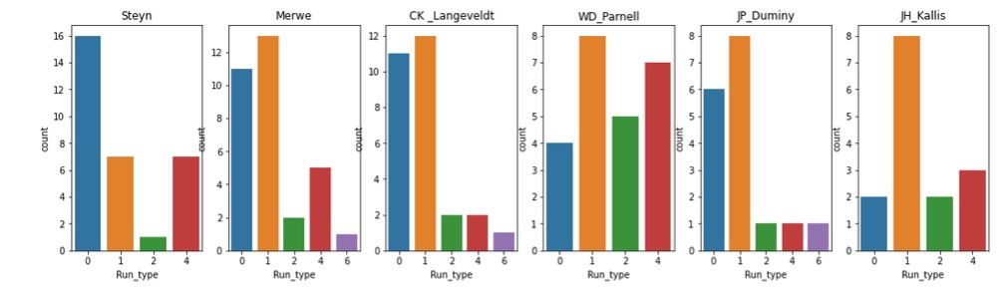

Slide 8
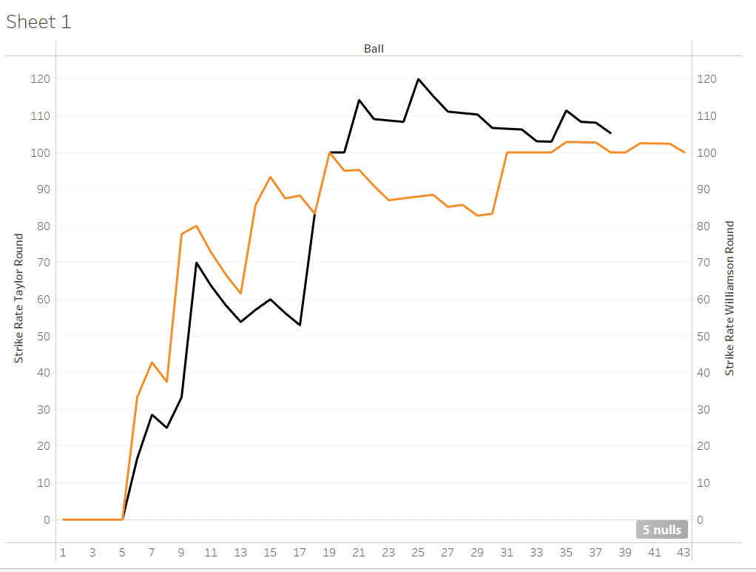
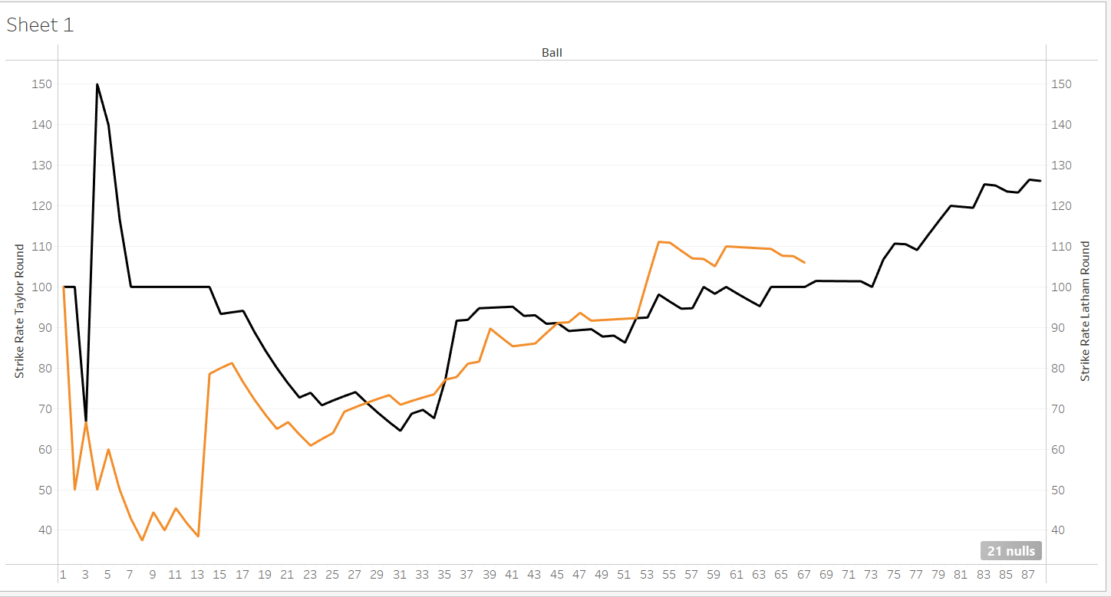
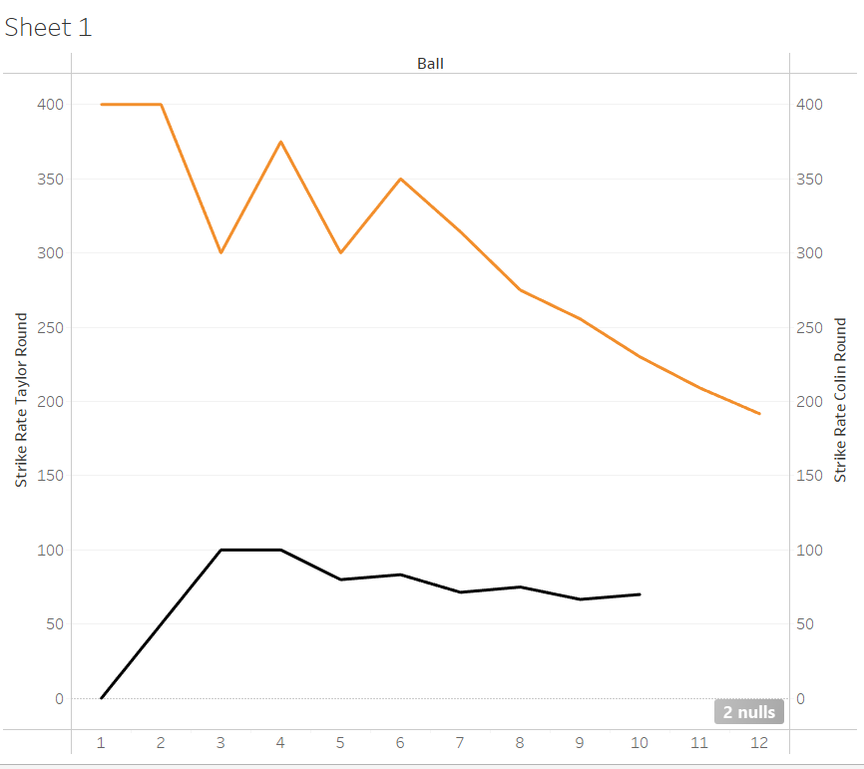
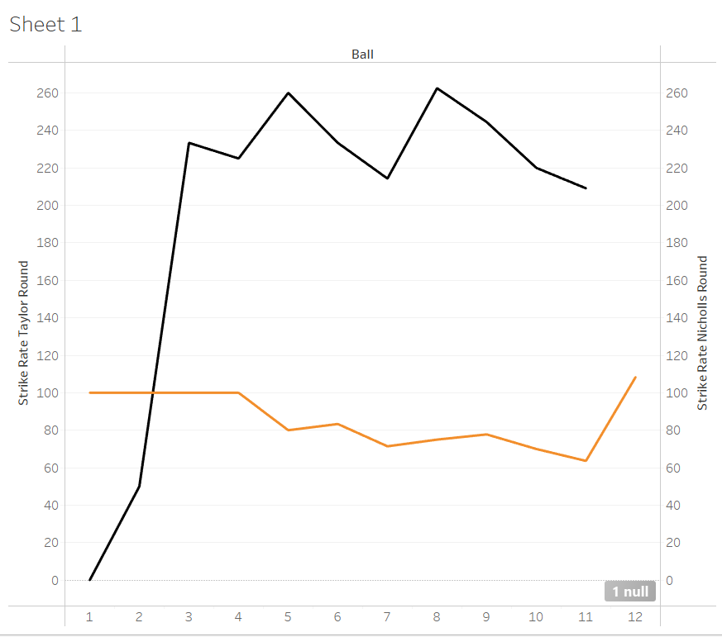

Slide 9
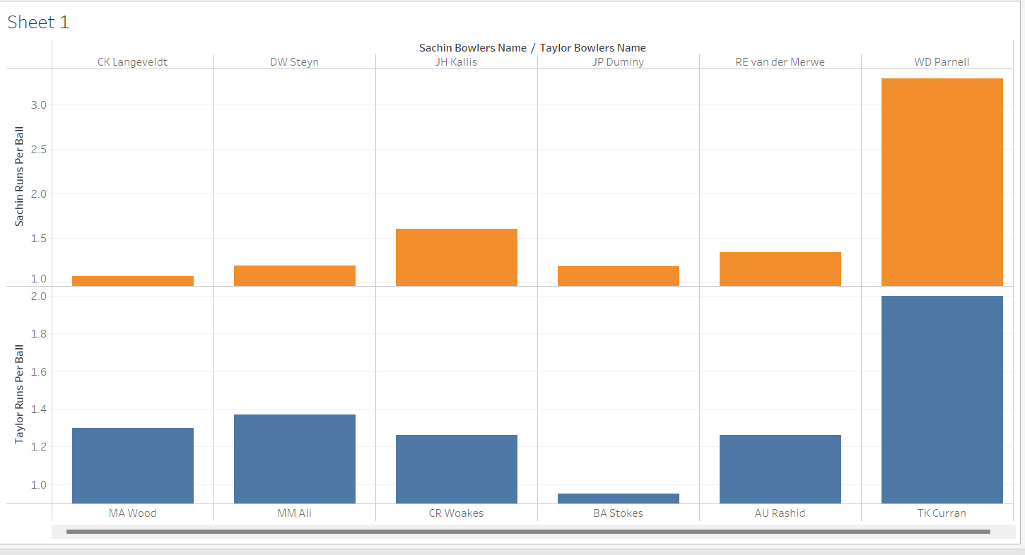

Slide 10
As 2 wickets fell down early so Ross Taylor and Kane Williamson had a shaky start where Taylor only played with a steady strike rate of 74.35
With the departure of the skipper Tom Latham joined Taylor and they both managed to sermon a 182 run partnership here Taylor played a major role and made [111 runs off 88 balls] and Latham[71 runs off 67 balls]
Colin de Grandhome came in the death overs while the team was chasing and smashed 23 runs off 12 balls which prohibited Taylor to have strike in this partnership and played only 10 balls and made 7 runs this slimmed his chances of managing a double hundred
As the team only had a few runs left this disallowed him to get a double hundred but he still played really well in this final partnership by scoring 23 runs off 11 balls

Slide 11
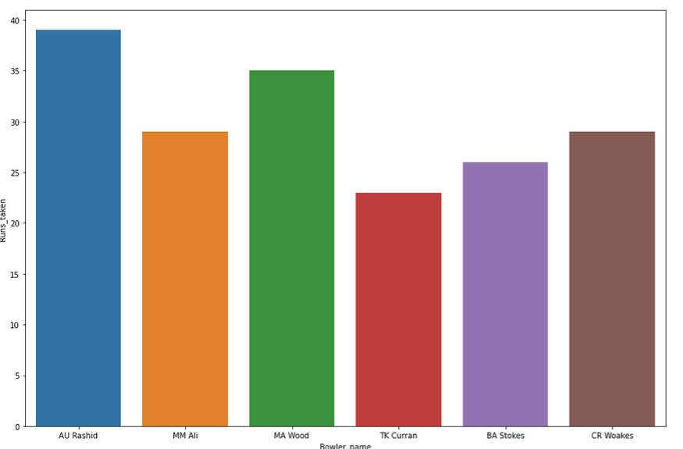

Slide 12
